Slide 1

The SK Salon Website
CS452 – Senior Software Engineering Capstone Project
Michelle Cominotto
Haley Hardwick
Taylor Jellico
Ben Wanagat
Spring 2017

Slide 2
The customer’s problem…
Sandee Kranz was in the process of opening up her own salon, The SK Salon. She needed a website for growing her customer base and getting relevant information to current customers. Ms. Kranz also needed a simple backend website to update her content and manage inventory, customers, and employees.

Slide 3
Challenge to the team…
Brand new development—no team had developed anything before
Learning PHP, MySQL, CSS, and HTML in a short amount of time
Understanding the unique needs of a salon website in order to design the best site possible.

Slide 4
Proposed solution
Design a clean, elegant, responsive website taking into account the colors and design wishes of the customer
Make sure the website is mobile-friendly
Design a clean, easy-to-use interface for the backend website that is powerful enough to contain all needed information
Create a database that links to both front and backend to make the webpage dynamic and editable by the customer without any coding experience
Create a user-friendly inventory app to account for sales, inventory, and customers

Slide 5
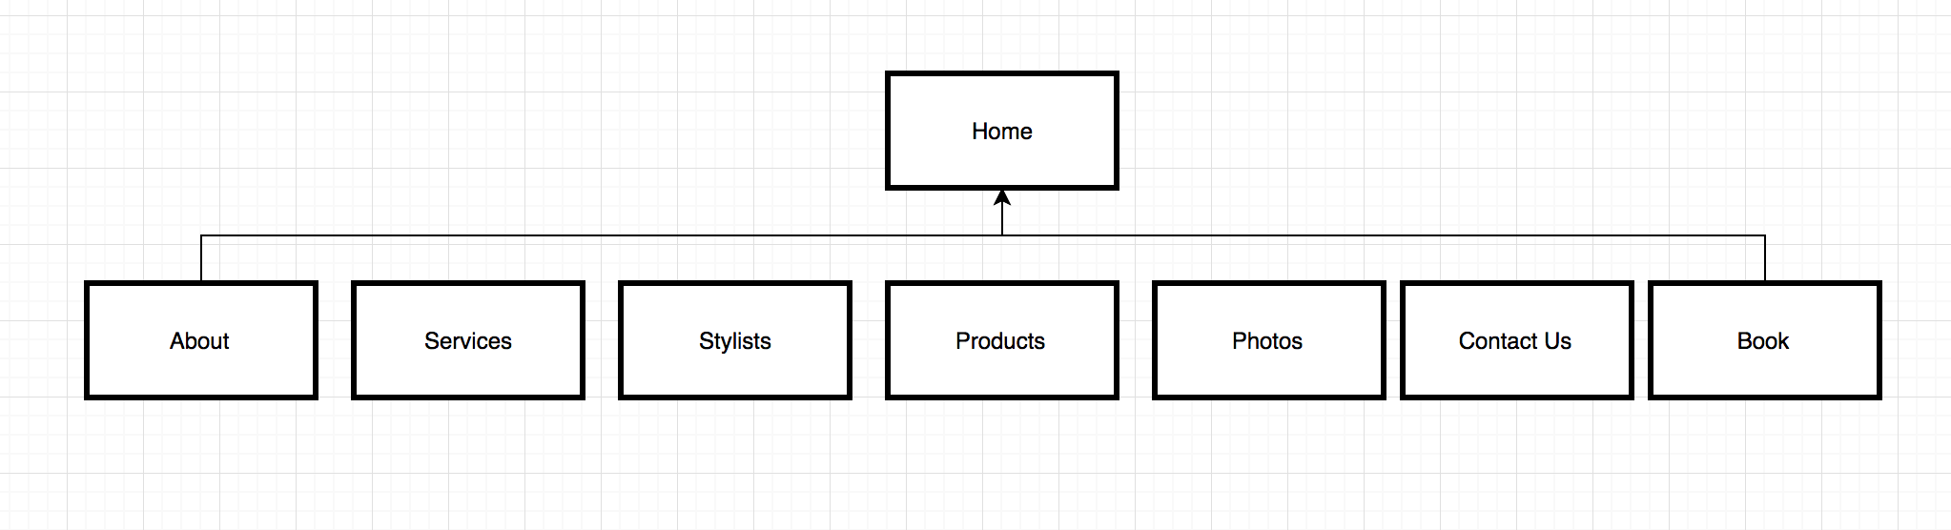
Details
Site Map (Main Site)

Slide 6
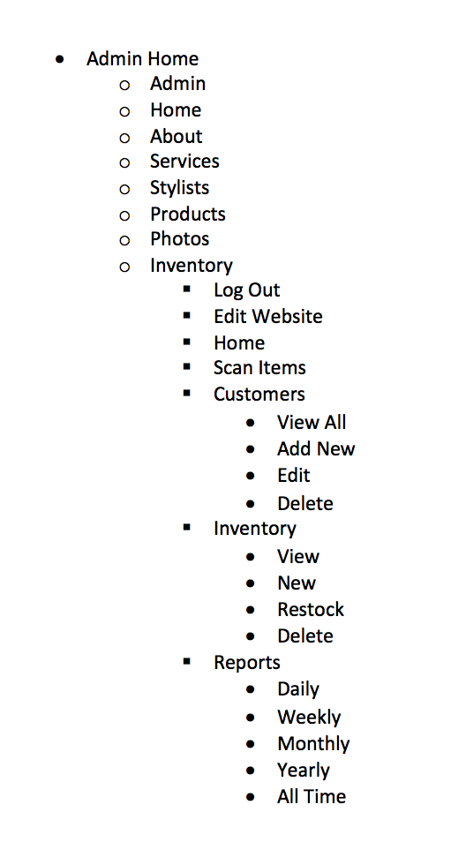
Details
Sitemap - Backend

Slide 7
Details
ERD Diagram

Slide 8

Details
Front End/Navigation/Design
Notes:
Add in responsive picture from phone

Slide 9
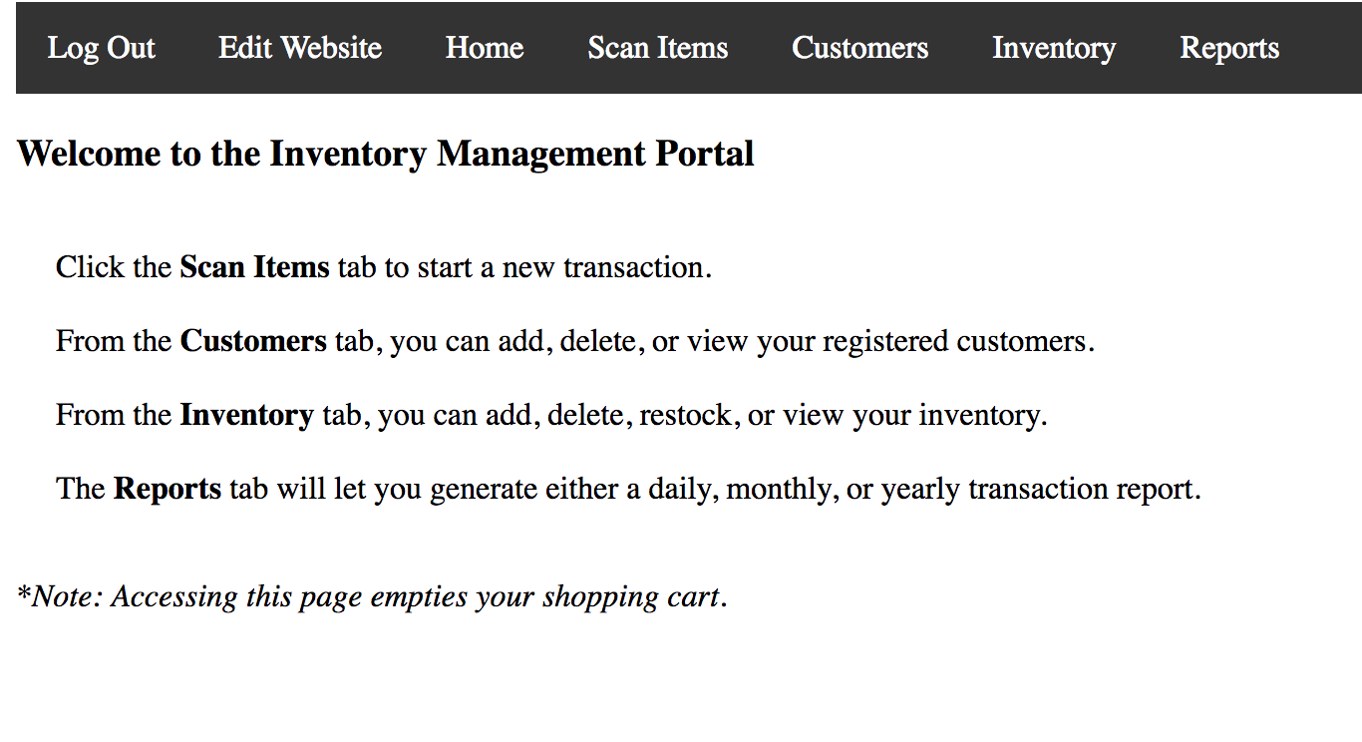
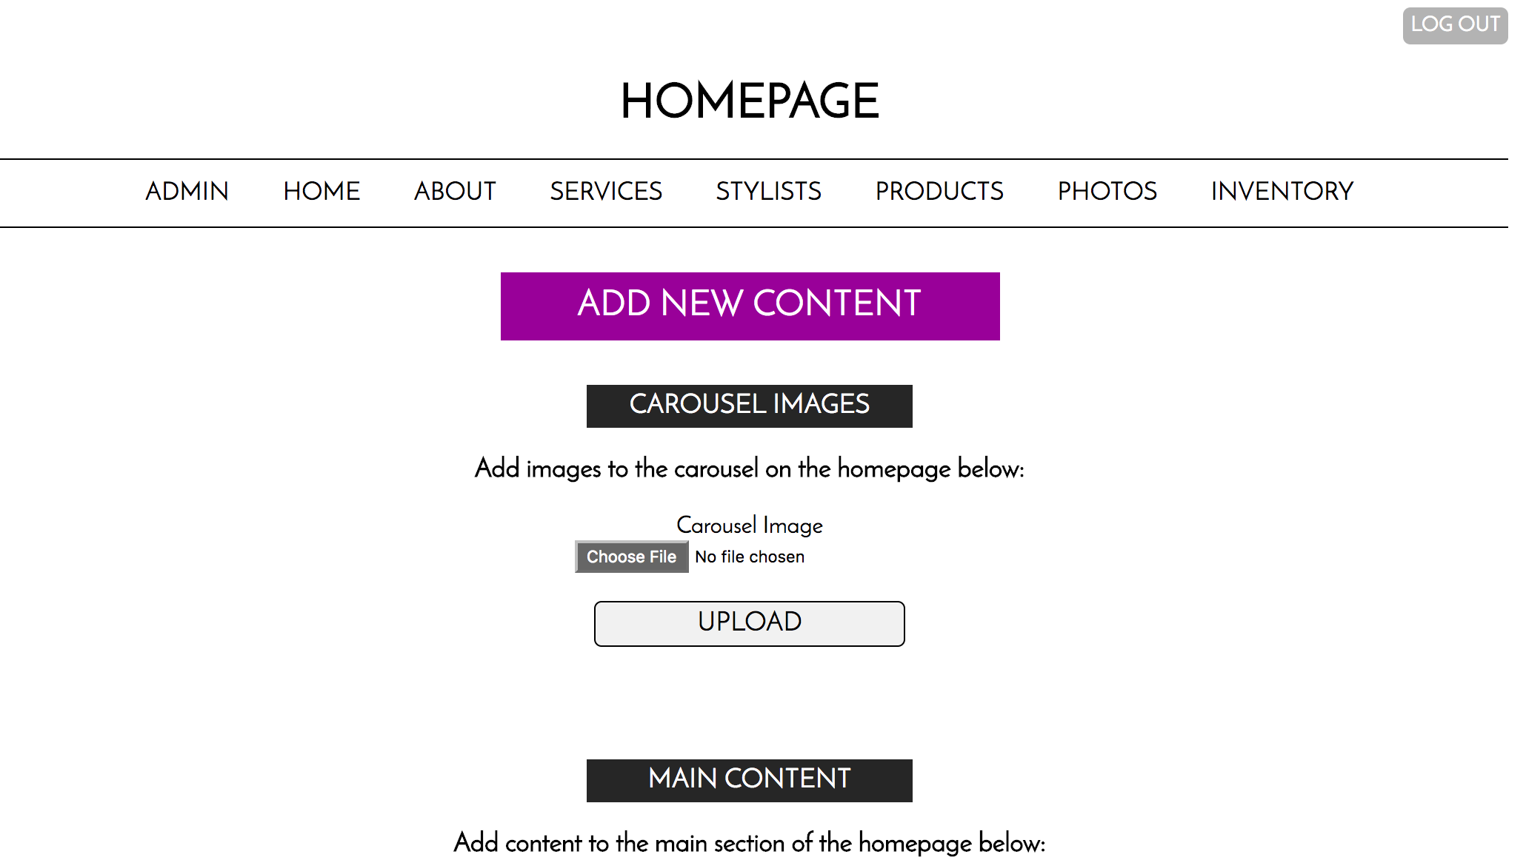
Details
Back end/Admin Portal

Slide 10
Results
The website meets all requirements standards set forth in the first customer meeting
Improvements were made based on customer feedback at the final meeting
The site is live and functioning, as per customer approval

Slide 11
Demonstration
Front End
Navigation
Layout of pages with sample data
Different layout of Photo Gallery (with lightbox) and Contact pages
Backend
Logging in/Logging out
Admin
Home
About (which is the same for Services, Stylists, and Products)
Photos (with added improvements)
Inventory
Adding a new item
Adding a new customer
Scanning a sale
Reports

Slide 12
Conclusions
The SK Salon website is now ready for further improvements:
More functionality building on the base
Incorporating different features
Solid base to add more options to grow and expand
We are proud of the work we were able to create in a short amount of time and feel we’ve created a solid base from which more work can grow.

Slide 13
Next steps
Adding a scheduling app
Adding functionality that would allow dragging and dropping content on the administrative portal
Add user permissions
Photo descriptions in the gallery
Advice for the group taking over this project:
Spend some time learning the nuances of PHP and MySQL before you begin tackling the next steps. It will save you time and effort when thinking about design and functionality.

Slide 14

THANK YOU FOR YOUR TIME
Michelle Cominotto
Haley Hardwick
Taylor Jellico
Ben Wanagat

